Slide 1

Engenharia de Software
Faculdade Anhanguera Jundiaí
Curso: CCS
ALM
Application Lifecycle Management
Prof. Rogério Moreira
rogerio_moreira@anhanguera.com
Agosto /2016

Slide 2
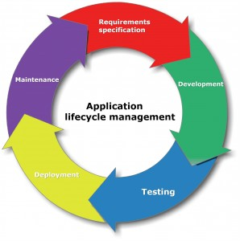
ALM – Aplication Lifecycle Management
https://www.practitest.com/application-lifecycle-management/

Slide 3
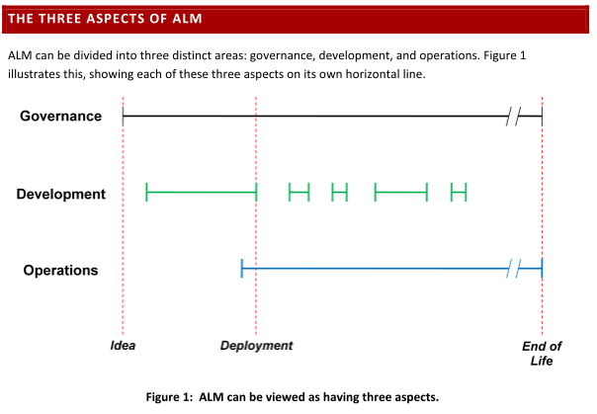
ALM – Aplication Lifecycle Management
tempo
(Chappell,2008)

Slide 4
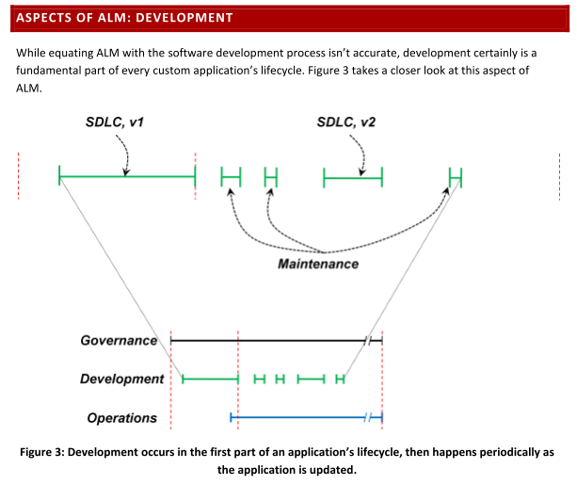
(Chappell,2008)

Slide 5
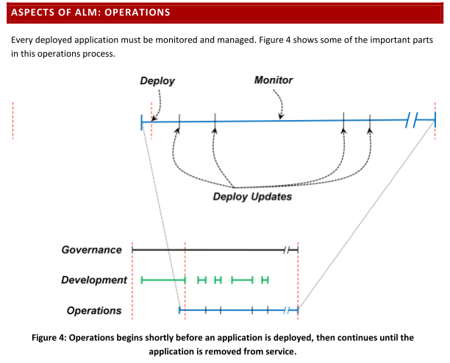
(Chappell,2008)

Slide 6
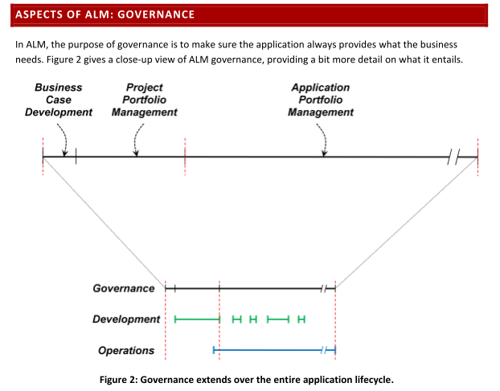
(Chappell,2008)

Slide 7
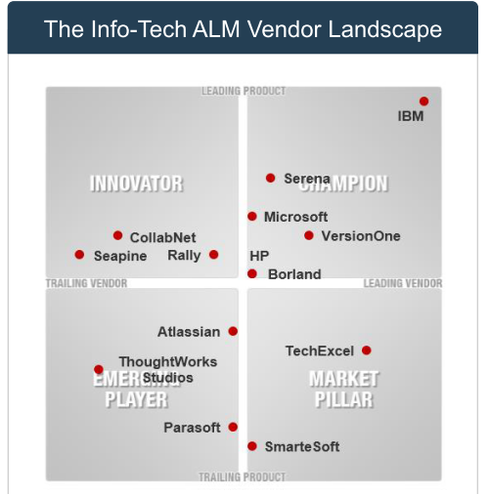
(INFOTECH,2014)

Slide 8
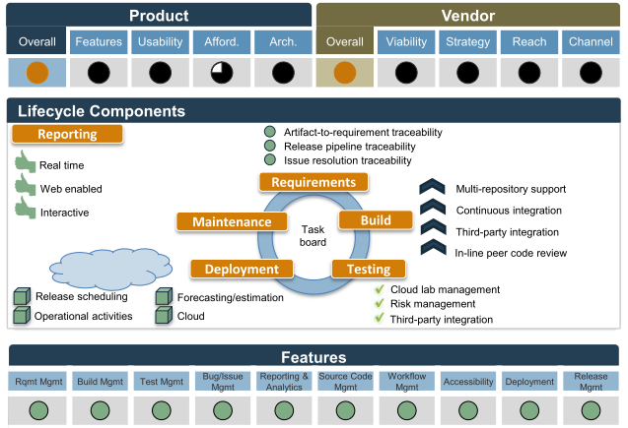
IBM Rational
(INFOTECH,2014)

Slide 9
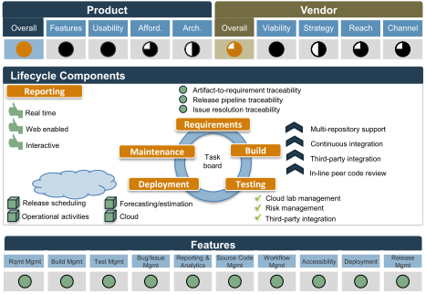
Serena Suite
(INFOTECH,2014)

Slide 10
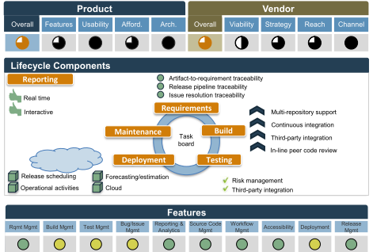
Microsoft Visual Studio Team Foudation Server (TFS)
(INFOTECH,2014)

Slide 11
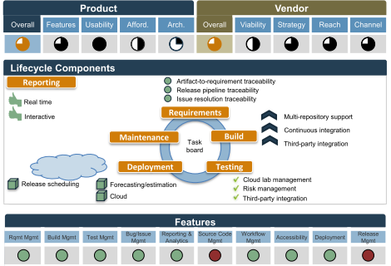
HP ALM
(INFOTECH,2014)

